Slide 1

ITC 6000 Database Management Systems Final Project Presentation 2020 Fall B Libby Database Presentation
Brad Viles
viles.b@northeastern.edu

Slide 2

Project Overview - Libby App
Libby allows users to access and download audio content from local public libraries
Users place holds on content
they are waiting for and
download borrowed content to
their personal device

Slide 3
User Personas
Commuters
Researchers
Children
Students
Avid readers
Insomniacs
Elderly
Poor vision
Accessed through public library membership
Large number of potential users based on number of libraries in US

Slide 4
Business Rules
Each USER may have many HOLDs
Each USER has one SHELF
Each SHELF may have many COPYs
Each USER may have many LIBRARY_CARDs
Each LIBRARY may have many LIBRARY_CARDs
Each LIBRARY_CARD has one USER and one LIBRARY

Slide 5
Business Rules contd.
Each LIBRARY has many COPYs
Each AUTHOR has many BOOKs
Each BOOK has many COPYs
Each PUBLISHER has many BOOKs
Each COPY has one EDITION
Each EDITION has one PUBLISHER and at least one AUTHOR

Slide 6
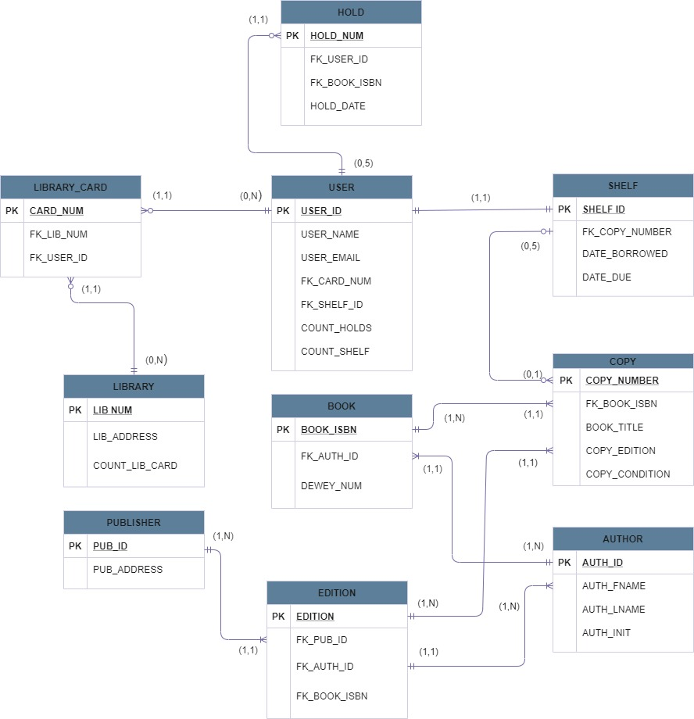
Libby ERD

Slide 7
Solution Architecture
Users expect to download and access audio content 24x7x365
Huge number of audio files requires either cloud architecture or on site server for scalability
Users will store some content downloaded to personal devices
Cap on shelf space means that device storage can be relatively small (2-3 GB)

Slide 8
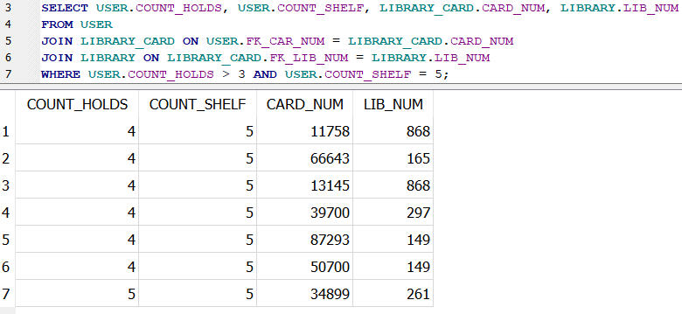
SQL - Users with full shelf and 4 or 5 holds

Slide 9
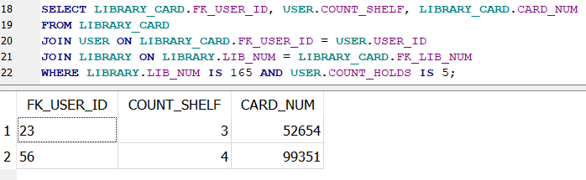
SQL - Users with 5 holds at library 165

Slide 10
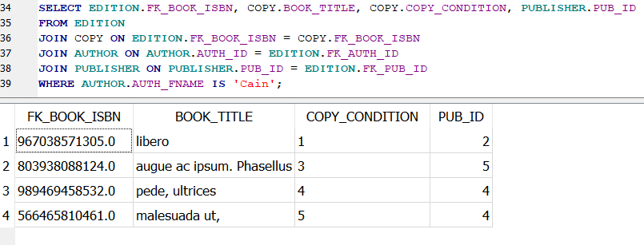
SQL - Selects all books by authors named “Cain”

Slide 11
Metrics
Library
active users, copies in circulation,
User
number of holds, copies borrowed per month, copies returned without listening
Book
percentage of time available for borrowing, number of active holds

Slide 12
Security/Privacy
No PCI/PHI involved
Some PII, although usually stored in library DB with library card as a key
Copyright issues, theft of IP if audio content is pulled from DB
Unlikely to be targeted

Slide 13
Key Takeaways
There are A LOT of ways to format tables and ERDs
Mainly project deals with allowing users small and specific access to a larger DB
Not a lot of moving parts, could have chosen something more challenging
Almost no privacy concerns, would be interesting to try building something with more sensitive data

Slide 14
Different Approaches
Try creating a DB that stores more data created over time or various types of data, e.g. sales data
Better understand architecture choices that would be relevant to a different type of data than audio files

